Slide 1

Assessment Report on the
Sustainable Use of Wild Species
www.ipbes.net
The Intergovernmental Science-Policy Platform
on Biodiversity & Ecosystem Services
#SustainableUse Assessment

Slide 2


Why is this assessment important
1.

Slide 3






50,000 Wild Species Meet Needs of Billions Worldwide
Experts Offer Options to Ensure Sustainable Use
1 in 5 People Rely on Wild Species for Income & Food
>10,000 Wild Species Harvested for Human Food
2.4 Billion People (1 in 3) Depend on Fuel Wood for Cooking

Slide 4
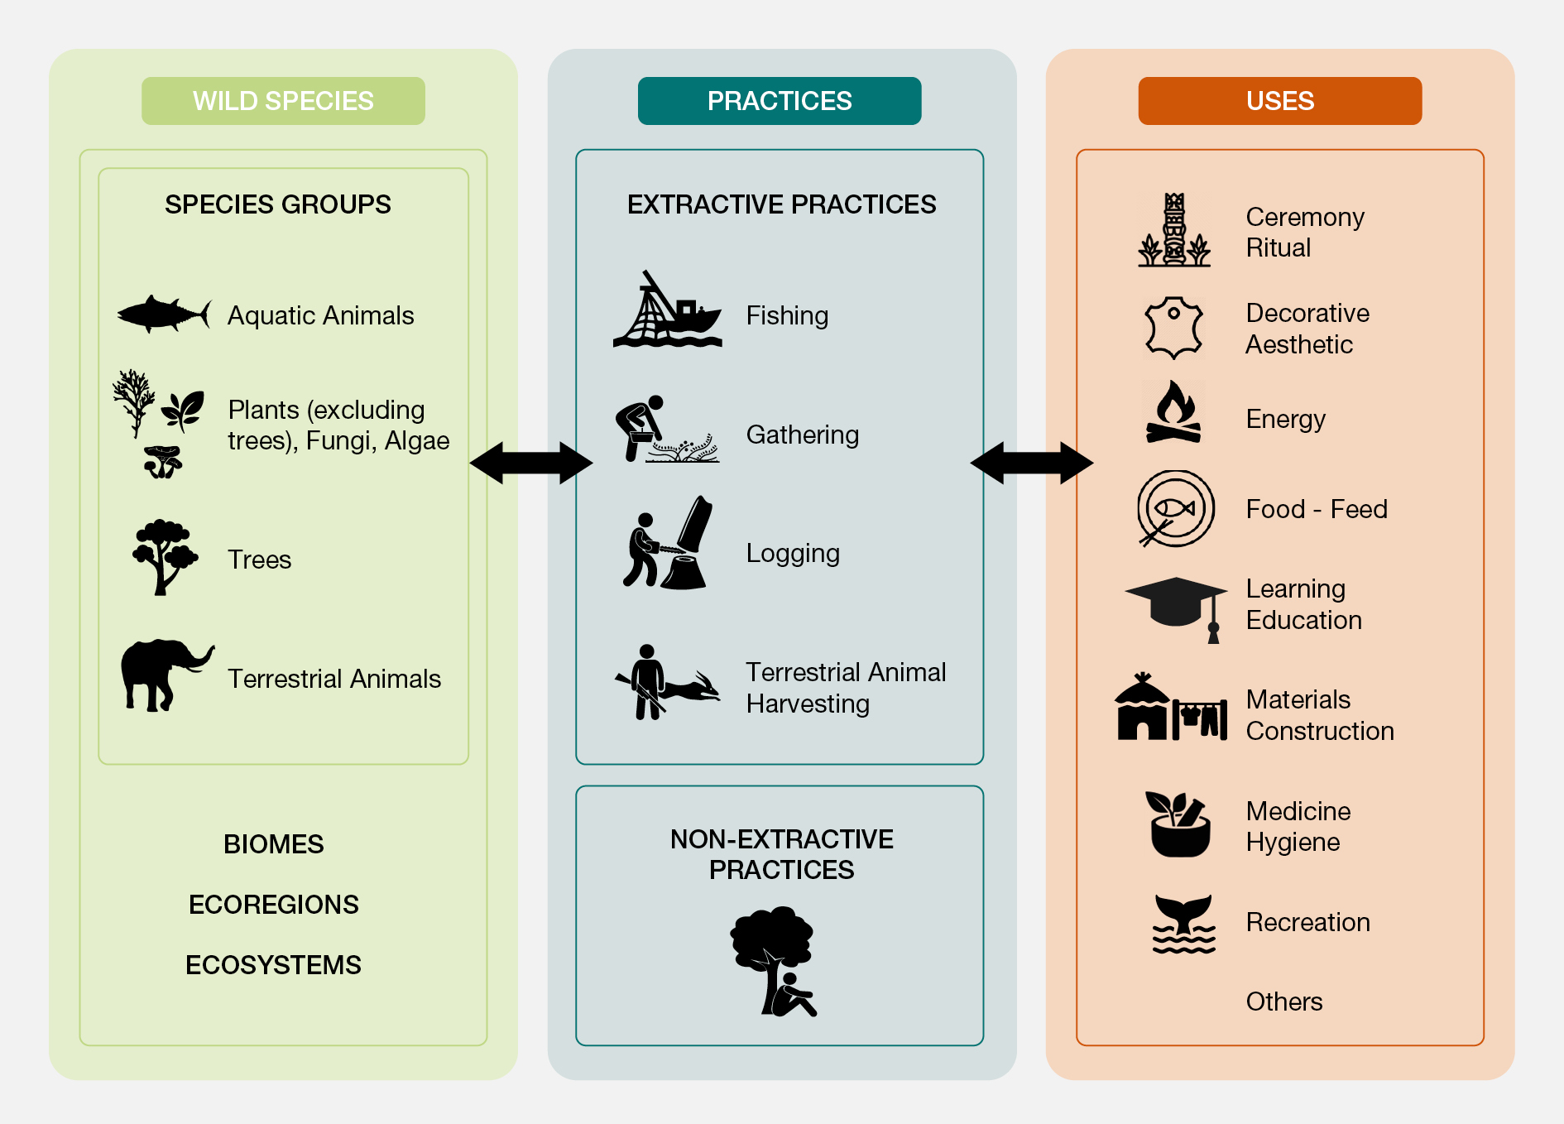
Describes the diverse uses of wild species
and associated practices

Slide 5
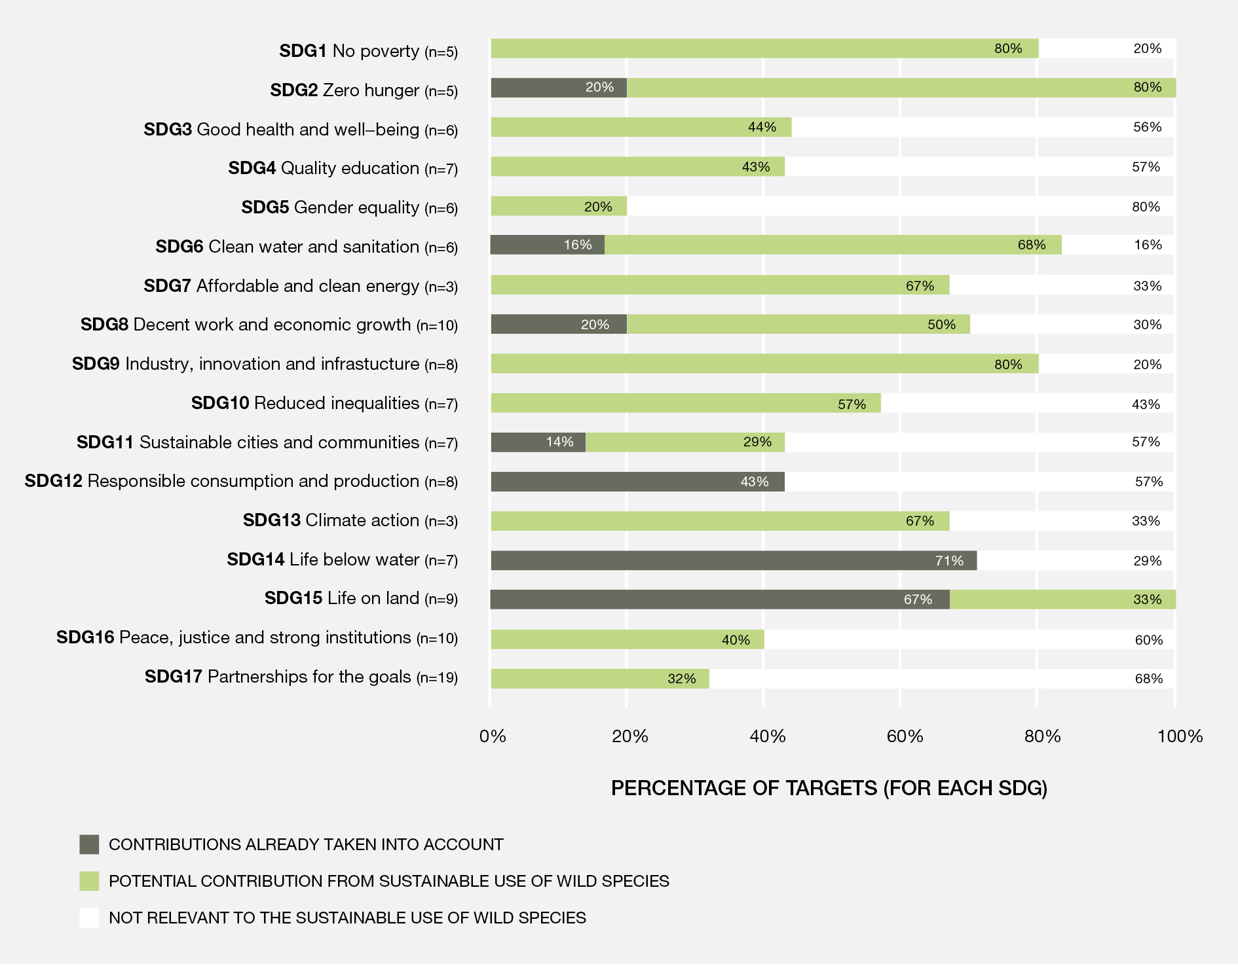
Explores what ‘sustainable use’ entails and how it relates to the UN Sustainable Development Goals

Slide 6
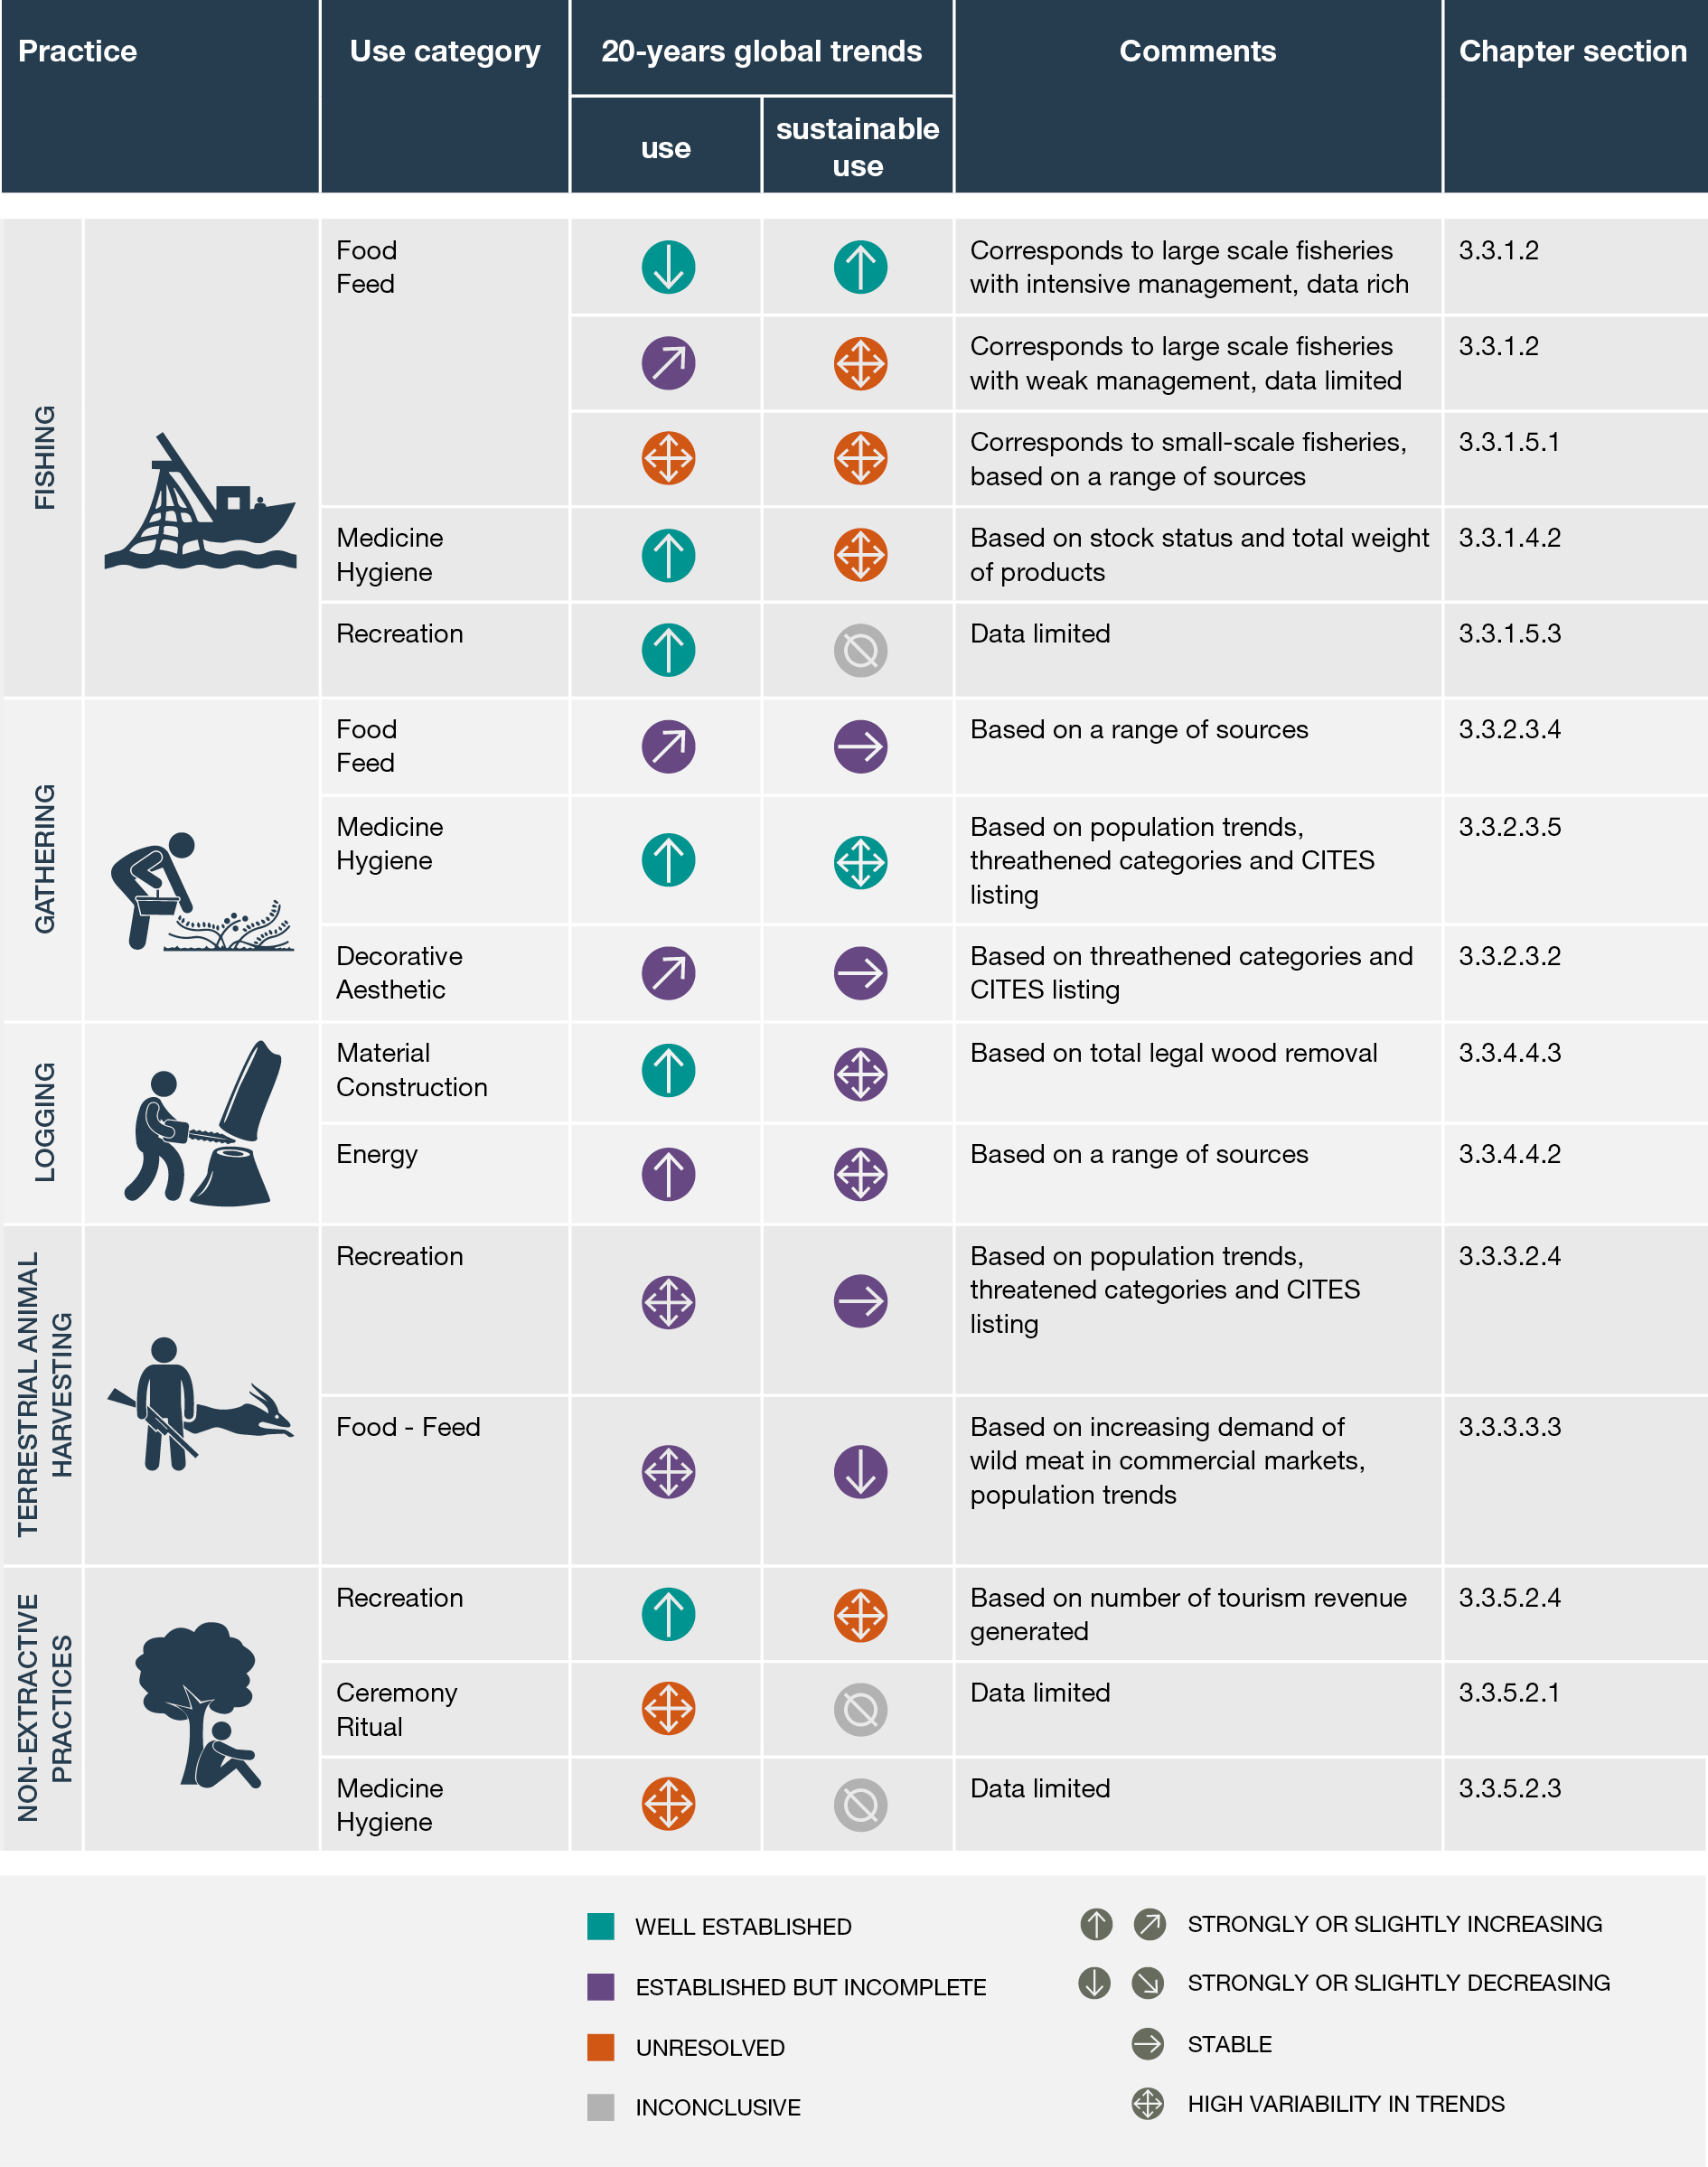
Assess status and trends in the use of wild species

Slide 7
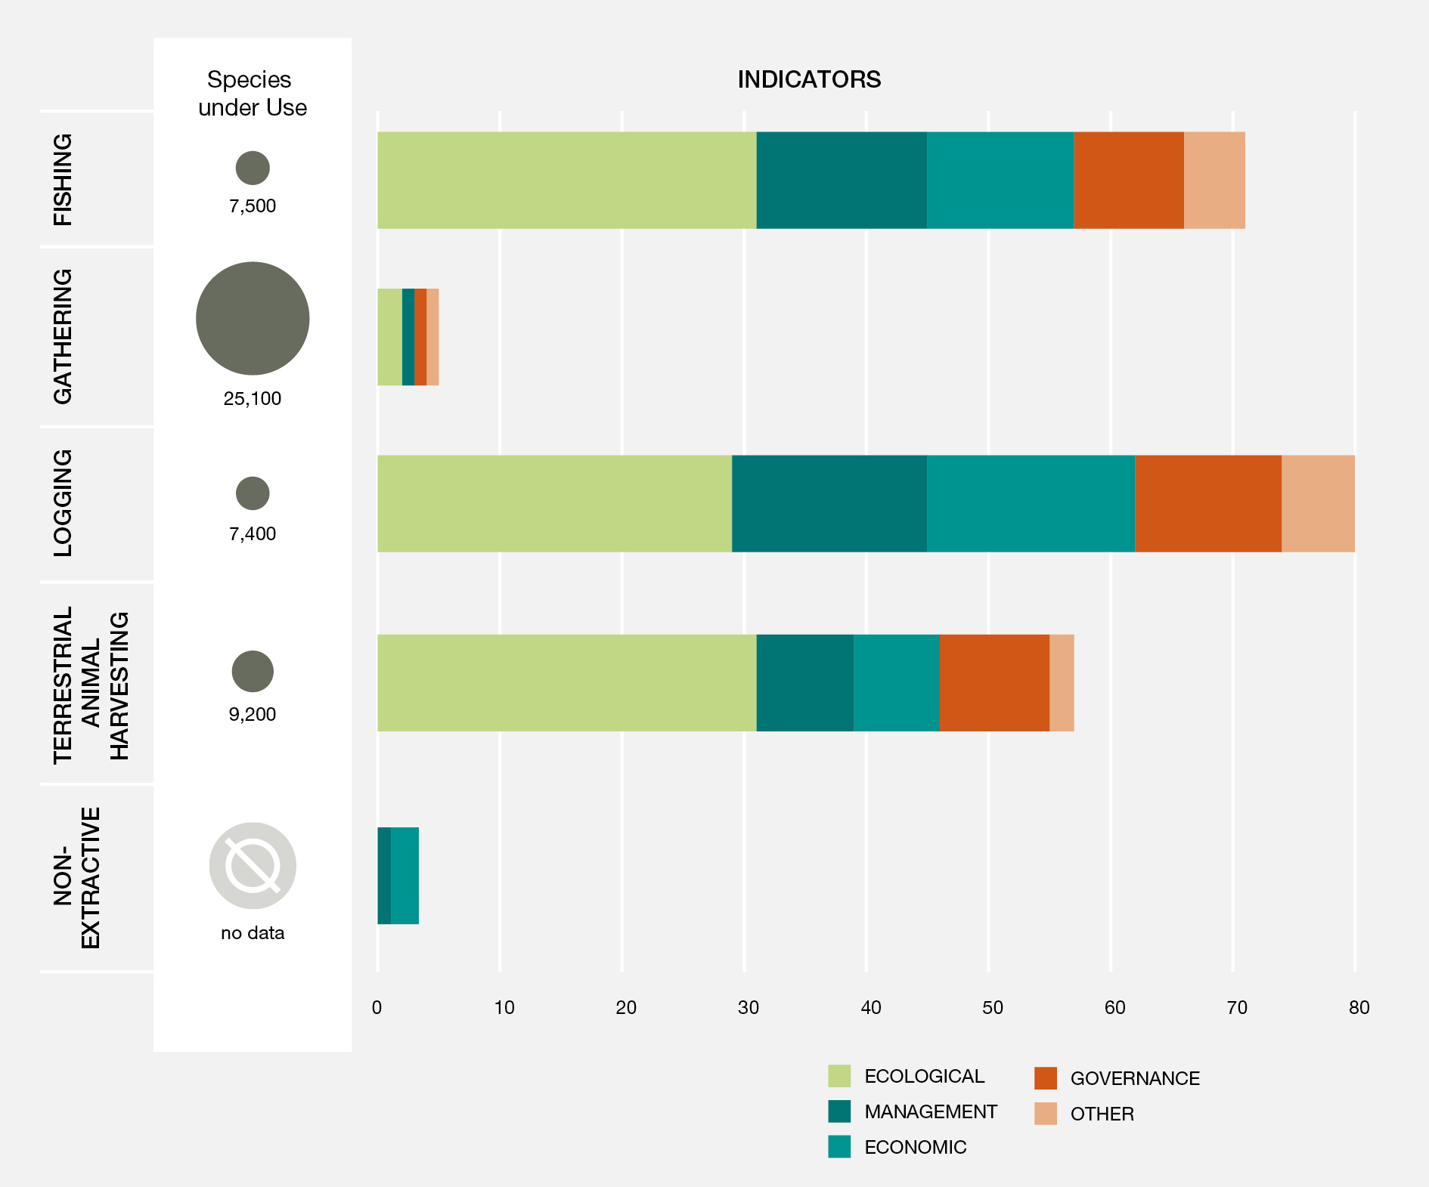
Assess
status and trends
in the use
of wild species

Slide 8
Identifies the environmental and social drivers that enhance or undermine the sustainability of use
Environmental drivers such as climate change, pollution and invasive alien species impact the abundance and distribution of wild species
Global trade in wild species is a major driver and has expanded substantially over the past 40 years
Illegal harvesting and trade in wild species involves numerous species and is the third largest class of illegal trade
Lack of attention to gender and equitable distribution of costs and benefits undermine the sustainability of use
Effective governance, institutions, education and public awareness can promote positive outcomes and mitigate negative impacts

Slide 9
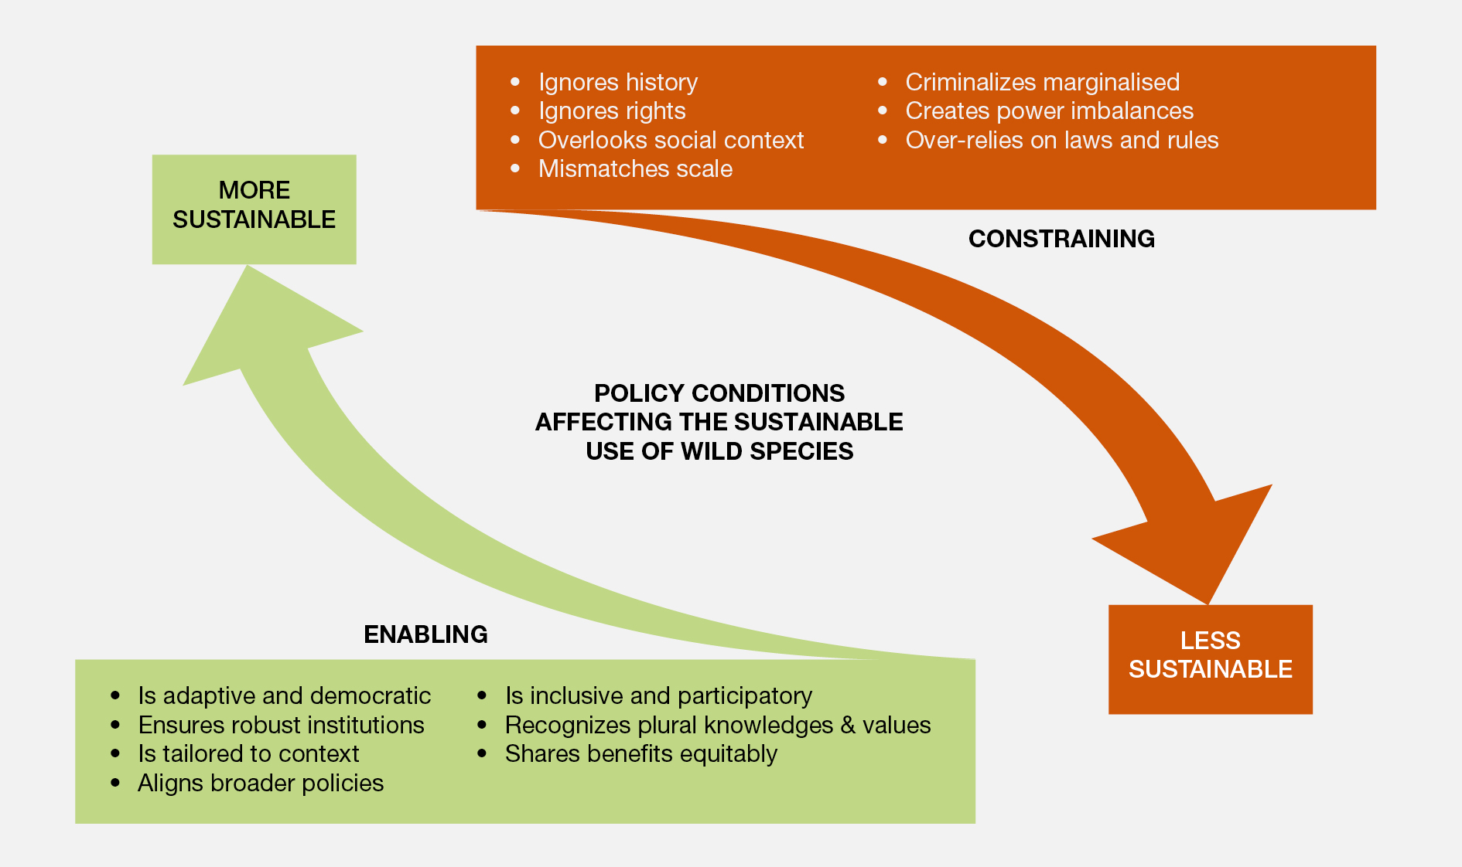
Identifies policy options & enabling conditions for sustainable use from national to global scales

Slide 10
Identifies 7 key elements & policy options
to strenghten sustainable use of wild species
Strengthen inclusive and participatory decision-making
Recognize and support multiple forms of knowledge
Ensure fair and equitable distribution of costs and benefits
Tailor policies to specific context
Monitor wild species and practices
Align policies at international, national, regional and local levels
Support robust institutions, including customary institutions

Slide 11
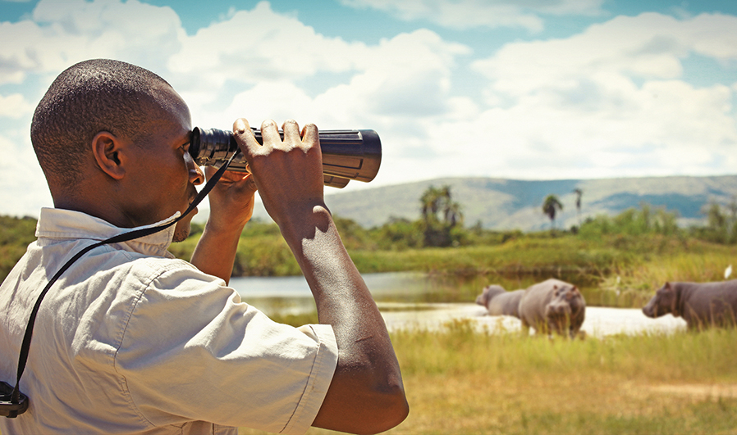
Expected impacts
2.

Slide 12
Provide best-available evidence, analysis and options for decision makers
Contribute to the work of the Convention on Biological Diversity (CBD) and support the implementation of the post-2020 global biodiversity framework
Contribute to CITES’ goal of ensuring international trade in wild species does not threaten their survival in the wild
Support implementation of the Sustainable Development Goals

Slide 13
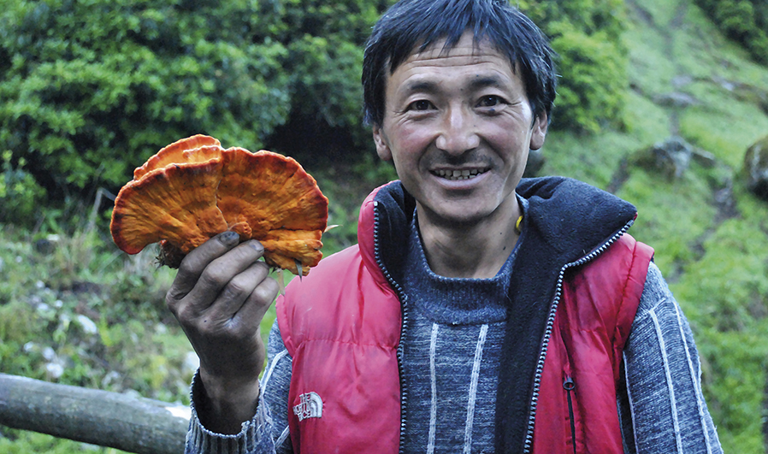
The Sustainable Use Team
3.

Slide 14
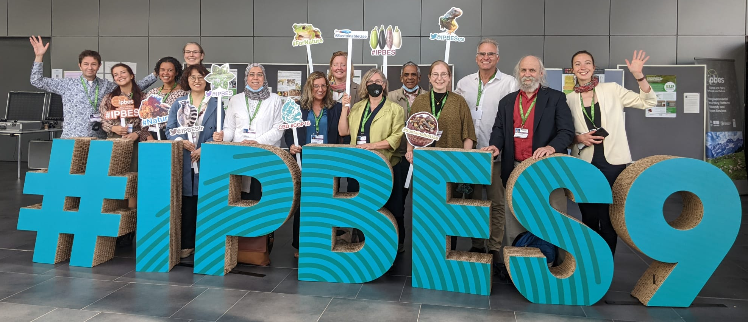
Multidisciplinary teamwork
  85 interdisciplinary experts and more than 200 contributing authors
  Natural and social scientists
Diverse knowledge sources
  Literature review: peer-reviewed and grey literature
  Indigenous and local knowledge
  Draws on more than 6,200 references

Slide 15

Thank you!
¡Gracias!
Merci!
#SustainableUse Assessment

