Slide 1

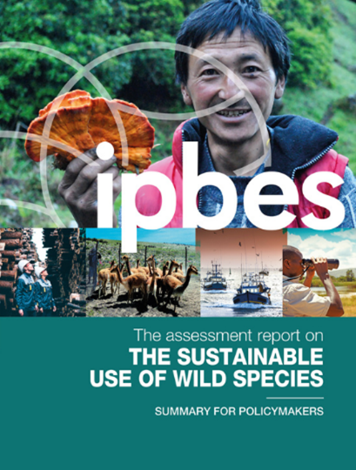
The summary for policymakers
#SustainableUse Assessment

Slide 2


The sustainable use assessment
The objective of the assessment is to:
Analyse status and trends in the sustainable use of wild species and drivers/causes of change
Consider approaches that enhance the sustainable use of wild species
Identify challenges and opportunities
Strengthen practices, measures, capacities and tools
Recognizing the “inseparable unity of nature and humanity”

Slide 3
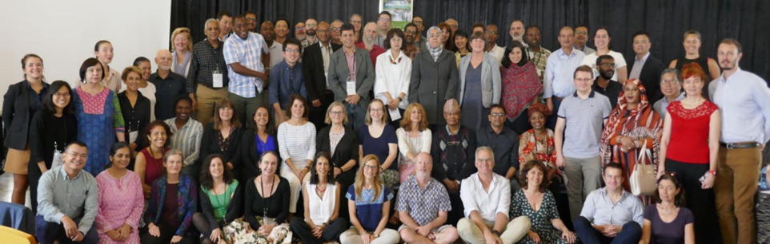
The sustainable use assessment
Started in 2018
3 co-chairs and 78 authors from 37 different countries
Approved by IPBES member states in July 2022

Slide 4
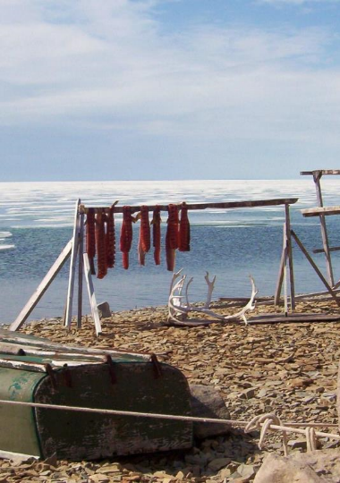
Sustainable use of wild species is critical for people and nature.
We know how to do this.

Slide 5
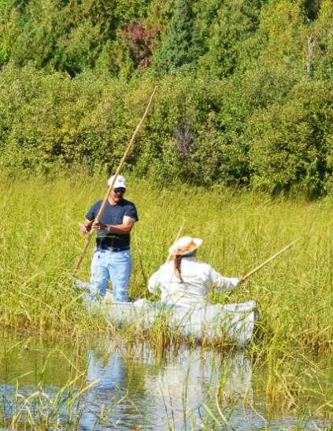
How do we know that?
Examples of uses that endured for millennia
Box SPM 1. Cultural keystone species: Wild rice in the Great Lakes region of North America

Slide 6
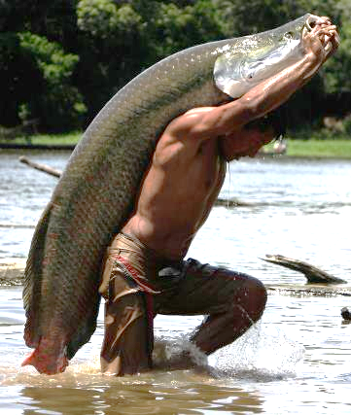
How do we know that?
Examples of local and regional uses that have been restored to sustainability.
Box SPM.4. Moving from unsustainable to sustainable: Pirarucu fishing in the Amazon
© Ricardo Oliveira

Slide 7

How do we know that?
Examples of global scale uses that have been restored to sustainability.
Box SPM.5. Moving from unsustainable to sustainable: Bluefin tuna

Slide 8
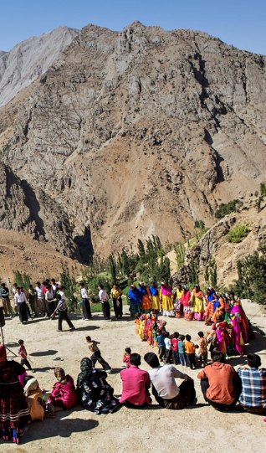
Why not just stop using wild species?
It’s inequitable
Doesn’t produce desired (ecological) results
But…sometimes, some species, in some places, for awhile…

Slide 9
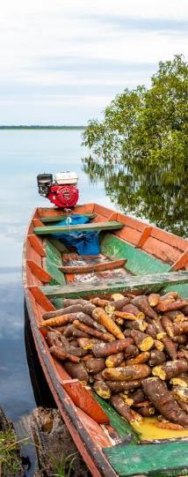
The sustainable use assessment
Summary for Policymakers (SPM)
6 Chapters:
  Setting the scene
  Conceptualizing sustainable use
  Status & trends
  Drivers
  Scenarios
  Policy options & responses

Slide 10
Characteristics of sustainable uses

Slide 11
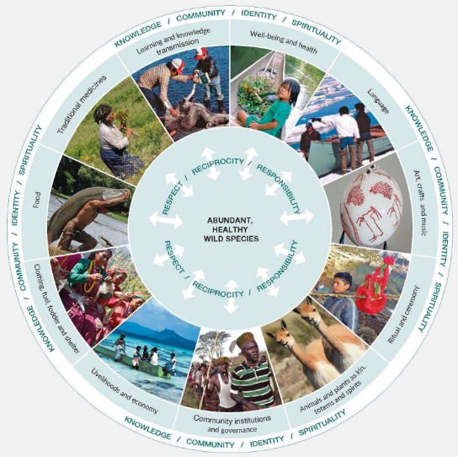
Figure SPM.3
Sustainable use of wild species is essential to the well-being of many IPLCs
In turn, sustainable use contributes to maintaining abundant, healthy wild species
Well-being and health
Language
Art, crafts and music
Ritual and ceremony
Animals and plants as kin, totems and spirits
Community institutions and governance
Livelihoods and economy
Clothing, fuel, fodder and shelter
Food
Traditional medicines
Learning and knowledge transmission

Slide 12
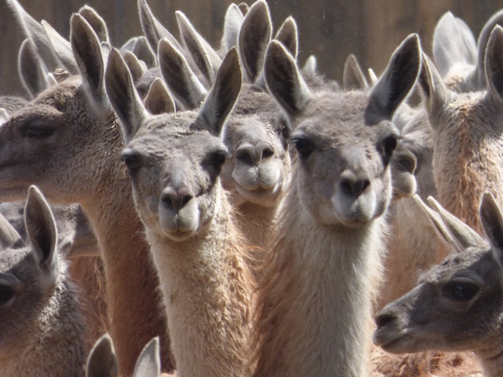
Thanks!
Looking forward to our discussion.
Photo by Gabriela Lichtenstein

Slide 13

The summary for policymakers (SPM)
  Policy relevant key messages
  Background information
Four sections:
Sustainable use of wild species is critical for people and nature
Status and trends of wild species use
Key elements and conditions for sustainable use
Pathways and levers to promote sustainable use in a dynamic future

Slide 14

Key messages:
A.1 Billions of people in all regions of the world rely on and benefit from the use of wild species for food, medicine, energy, income and many other purposes.
A.2 Sustainable use of wild species is central to the identity and existence of many IPLCs.
A.3 Ensuring sustainability of the use of wild species is critical to reverse the global trend in biodiversity decline.

Slide 15

(A.2.2) Sustainable use contributes to the livelihoods of IPLCs through subsistence, as well as trade in informal and formal markets
Food, medicine, fuel and other livelihood resources
In both developed and developing countries
Often considered nutritionally superior to cultivated species or other substitutes
Often no culturally acceptable alternative for ceremonies and rituals
Basis for culturally meaningful employment
Long-distance trade for millennia – continues to be important

Slide 16

(A.3.3) Indigenous peoples manage fishing, gathering, terrestrial animal harvesting and other uses of wild species on more than 38 million km² of land in 87 countries.
This coincides with approximately 40% of terrestrial conserved areas, including many with high biodiversity
Deforestation is generally lower on indigenous territories
Sustainable use increases biodiversity while supporting well-being and livelihoods
(A.1.5) An estimated 15% of global forests are managed as community resources by IPLCs

Slide 17
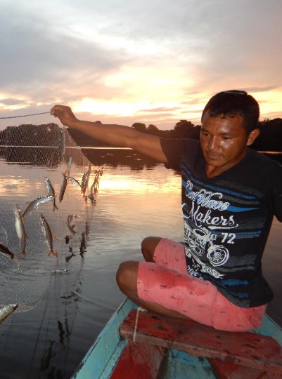
Section B: Status and trends in the use of wild species

Slide 18

Key messages:
B.1 Status and trends in the uses of wild species vary depending on types and scales of use, and social ecological contexts.
B.2 The sustainability of the use of wild species is influenced negatively or positively by multiple drivers.
B.3 Key elements of sustainable use have been identified in relevant international and regional standards, agreements and certification schemes but indicators are incomplete, most notably for social components.

Slide 19

(B.2.6) Multiple drivers threaten IPLCs’ ability to maintain and restore sustainable use
National and sectoral policies (e.g. forestry, agriculture, energy, conservation…) often do not support rights of IPLCs to access lands, territories and customary sustainable resources
      Lack of data and indicators to monitor progress

Slide 20
(B.2.6) continued…
Other negative factors include:
  loss of indigenous and local languages
  education programs divorced from local, cultural and environmental conditions
  lack of attention to gendered roles
  integration into monetized and commodified economic systems

Slide 21

(B.2.7) Secure rights over land and resource use and trade can incentivize resource conservation, sustainable use, and diverse livelihoods
Gives more opportunities for effective regulation of use patterns and allows for longer-term planning
However, illegal seizures of land violate the rights of indigenous peoples, diminishing food security and conservation outcomes

Slide 22
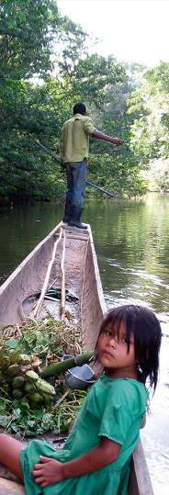
(B.2.15) Education, communication and public awareness are key drivers of sustainable use, but they are seldom prioritized as policy options
More effective when:
promote time outside in nature
respect the cultures and languages of IPLCs
include women and girls, elders and youth
promote intra- and intergenerational transmission of knowledge
Recognizing and embedding ILK into education systems supports sustainable use

Slide 23
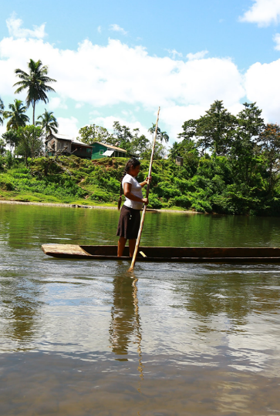
C. Key elements and conditions for the sustainable use of wild species

Slide 24

Key messages:
C.1 Policy instruments and tools are most successful when tailored to the social and ecological contexts and when they support fairness, rights and equity.
C.2 Policy instruments and tools are more effective when they are supported by robust and adaptive institutions and are aligned across sectors and scales. Inclusive, participatory mechanisms enhance the adaptive capacity of policy instruments.
C.3 Effective monitoring of social, economic, and ecological outcomes supports better decision-making. Scientific evidence is often limited, and ILK is underutilized and undervalued.

Slide 25

(C.1.1) Conceptualizations of sustainable use influence policymaking
However, cultural contexts receive little attention
This leads to lack of recognition of the practices of IPLCs and support for their tenure and access rights

Slide 26
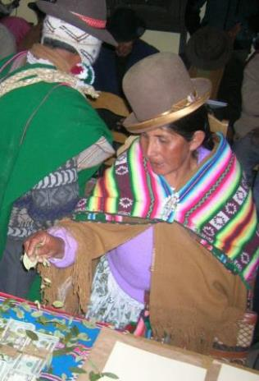
(C.1.3) Fairness, rights and equitable distribution of benefits are essential to ensure sustainable use
Small producers lose out if measures are drafted that primarily promote the interests of the advantaged
In contrast, to positively influence sustainable use:
secure rights of access and use
social capital
participation in governance
Accountability
(C.1.4) Certification is often beyond the reach of small-scale producers, including IPLCs
Box SPM.3 Distribution of benefits from vicuña fiber to indigenous communities in the Andes

Slide 27

(C.2.4) Strengthening customary institutions and rules often contributes to sustainable use
Reduces conflicts and increases policy effectiveness
Lowers costs for monitoring and enforcement
Supports the ecological, economic and particularly social dimensions of sustainability
However, cultural systems have seldom been incorporated into policies

Slide 28

(C.3.1) Monitoring of ecological, social and economic aspects is critical for sustainable use
Many IPLCs have well developed monitoring practices
Examples: amount of caribou back fat or changing flavor of fish
Knowledge can be passed from generation to generation, in timeframes longer than most scientific studies
There are increasingly robust networks of IPLCs dedicated to monitoring

Slide 29
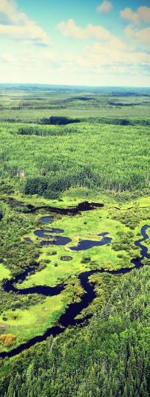
(C.3.2) Policy instruments and tools are more effective when they are inclusive of plural knowledge systems
Bringing together scientists and holders of ILK and coproduction of knowledge improves decision-making
Inclusion of IPLCs in the development and implementation of policies requires:
sustained commitment
recognition of both systems as authoritative
free, prior and informed consent
protocols on access and benefit sharing

Slide 30
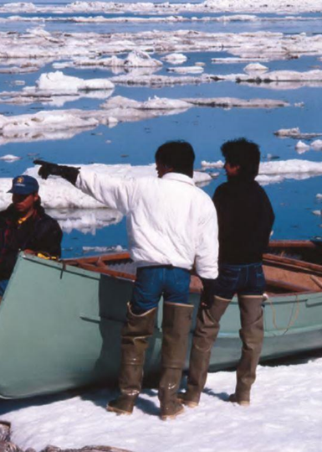
Section D.
Pathways and levers to promote sustainable use in a dynamic future

Slide 31

Key messages:
D.1 Sustainable use in the future is likely to be challenged by:
climate change
increasing demand
technological advances
Addressing these challenges will require transformative changes
D.2 Concerted interventions will be needed to implement and scale-up policy actions
D.3 The world is dynamic and therefore sustainable use requires:
constant negotiation and adaptive management
a common vision of sustainable use
transformative change in the human-nature relationship

Slide 32
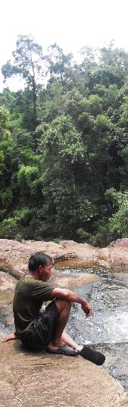
(D.2.1) Seven key elements (sets of policy actions) could be levers of change:
Inclusive and participatory decision-making
Inclusion of multiple forms of knowledge and recognition of rights
Equitable distribution of costs and benefits
Policies tailored to local social and ecological contexts
Monitoring (social and ecological)
Coordinated and aligned policies
Robust institutions from customary to statutory

Slide 33
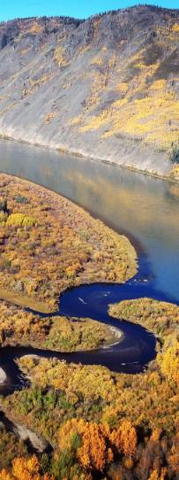
(D.3.4) Sustainable use will benefit from a transformative change in the prevailing conceptualization of nature.
Considering humanity to be part of nature would lay the foundation for a more respectful and sustainable relationship, as shown by IPLCs’ traditional practices and uses

Slide 34

Knowledge gaps: Indigenous and local knowledge
Methods co-developed with IPLCs for weaving science and ILK
Documentation of ILK regarding sustainable use, observing FPIC
Monitoring processes and indicators co-produced with IPLCs
Scenarios co-produced with IPLCs
Approaches to support and revitalize ILK and customary governance
Capacity-building and support for IPLCs to conduct research, monitoring and governance

Slide 35

Thank you!
¡Gracias!
Merci!
#SustainableUse Assessment

